Slide 1
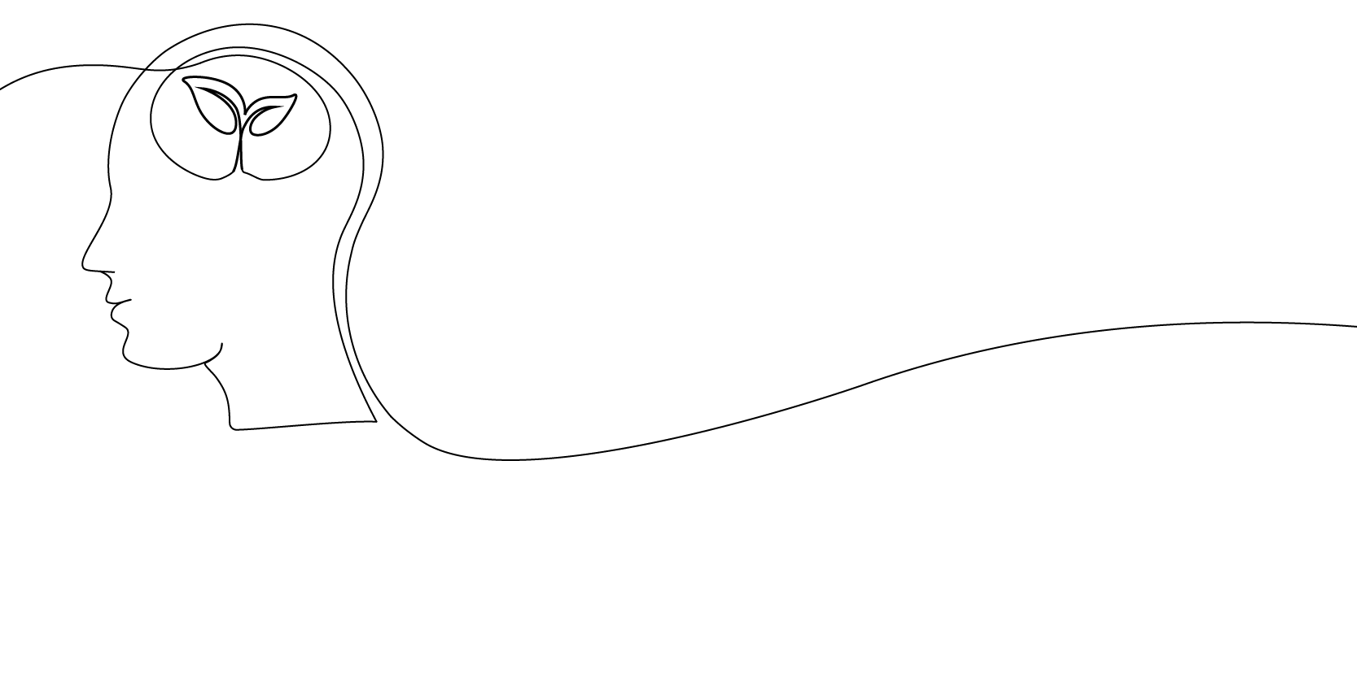

10 ways to reduce your risk of dementia
Notes:
This slide deck was prepared by the Alzheimer Society of Canada in September 2023 to help spread the word about some of the top ways folks can reduce their risk for dementia.
Related webpage is available at alzheimer.ca/reduceyourrisk.
This slide deck can be re-used in its original form for educational and non-profit purposes as long as credit is provided to the Alzheimer Society of Canada.
Alternatively, if you wish to adapt this presentation or change it for re-use, or if you wish to use it or adapt it for for-profit purposes, please email publications@alzheimer.ca for permissions.

Slide 2

While some risk factors for dementia can’t be changed, there are many ways you can
reduce your overall dementia risk.
Notes:
Let's be clear as we start
There are many risk factors for dementia that can't be changed, like genetics and age.
And just as with things like cancer, your risk for dementia never drops to zero. Everybody carries some degree of risk for dementia

Slide 3
Follow as many of these 10 evidence-based actions as you can to reduce your risk of developing dementia.
Notes:
The question is: what can you do to reduce your risk?
The good news is there are many actions many of us can take.
What we will focus on here today are 10 top actions you can take that are known to reduce the risk.
All of these risk factors are from the 2020 Lancet Commission report on dementia prevention, intervention and care at https://doi.org/10.1016/S0140-6736(20)30367-6
Experts say if you can't take action on one of these risk factors, try to take action on others.
And the more actions you can take, the better.
Also if you ever want to look these tips up, just visit alzheimer.ca/reduceyourrisk

Slide 4
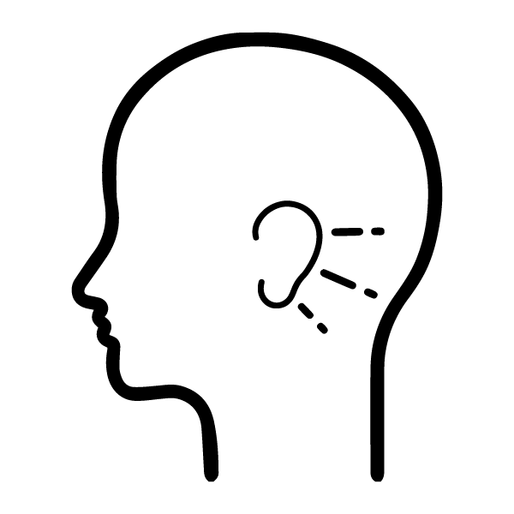
Protect and support your hearing
Hearing loss in midlife can increase relative dementia risk by an average of 90%.
But that risk is largely eliminated if you use a hearing aid to correct for that loss.
Notes:
All the percentage stats in this slide deck come from the 2020 Lancet Commission report on dementia prevention, intervention and care. Link: https://doi.org/10.1016/S0140-6736(20)30367-6
Need help with hearing loss? Talk to your health-care provider. And check out the Canadian Hard of Hearing Association resources and e-store at chha.ca. It includes resources for preparing for a health-care visit. Or call 1-800-263-8068 or email info@chha.ca

Slide 5

Seek support for depression
Depression in later life can increase relative risk of dementia by an average of 90%.
Depression is treatable! Seek help from a health-care provider.
Notes:
- Free 24/7 support for mental health is available at wellnesstogether.ca, 1-866-585-0445 or text WELLNESS to 741741
"Depression is among the most treatable of mental disorders. Between 80% and 90% percent of people with depression eventually respond well to treatment. Almost all patients gain some relief from their symptoms." -- American Psychiatric Association https://www.psychiatry.org/patients-families/depression/what-is-depression#:~:text=Depression%20is%20among%20the%20most,some%20relief%20from%20their%20symptoms.

Slide 6

Avoid concussion and traumatic brain injury
Traumatic brain injury in midlife can increase relative risk of dementia by an average of 80%
If you have had traumatic brain injury in the past, you can still reduce your dementia risk by taking action on the other fronts we've identified.
Also try to avoid traumatic brain injury in future by paying attention to surroundings when walking, rolling or driving; avoiding risky activities; and playing safe.
Notes:
-More information about brain injury and living well with it is available at from Brain Injury Canada at braininjurycanada.ca
-More information about injury prevention in general is available at parachute.ca/concussion
According to Parachute.ca,
Concussion prevention
The best way to prevent concussions is to prevent the incidents that cause concussions, such as falls and motor vehicle collisions.
Concussion prevention in sports and recreation includes:
Respecting and following the rules of the sport or activity, especially rules that are in place to reduce hits to the head
Wearing properly fitted equipment, such as the right footwear to prevent falls
Training, practising and playing in ways that are appropriate for your skill level
Developing and enforcing policies and rules in sport to prevent injury, such as minimum bodychecking age in hockey. According to current research, these kinds of policies are the most effective way to prevent sport-related concussions.

Slide 7

Stay socially active
Social isolation in later life can increase relative dementia risk by an average of 60%.
Suggestions for older people from the National Institute on Aging in the US include:
Playing cards or other games with friends in person or online.
Travel with a group of older adults, such as a retiree group
Video chat or call your friends and family members
Try different restaurants with your loved ones.
Join a group interested in a hobby such as knitting, hiking, birdwatching, painting or wood carving.
Reconnect with old friends through your high school or college alumni association.
Volunteer at a school, library, museum, hospital or animal shelter
Visit a community or senior centre and take part in its activities
Notes:
This list of tips is from the US National Institute on Aging – link - https://www.nia.nih.gov/health/participating-activities-you-enjoy-you-age

Slide 8

Protect your heart
High blood pressure in midlife increases relative risk of dementia by an average of 60%
If you have been prescribed antihypertensive medication, take it! Antihypertensive treatment for hypertension is the only known effective preventive medication for dementia.
What's good for the heart is good for the brain!
Monitor and manage your blood pressure and heart health
Notes:
-The information about antihypertensive medication in 2nd bullet point, and also all the percentage stats in this slide deck, come from the 2020 Lancet Commission report on dementia prevention, intervention and care. Link: https://doi.org/10.1016/S0140-6736(20)30367-6
-Talk to your health-care provider about maintaining your heart health
-Visit heartandstroke.ca for tips on protecting your heart health - and support for recovering from heart issues

Slide 9

Quit smoking
Smoking in later life can increase relative risk of dementia by 60%
Stopping smoking, even in later life, ameliorates this risk
Talk to your health-care provider
Notes:
Find free support for quitting smoking at canada.ca/quitsmoking or smokershelpline.ca
You can also reach Smokers' Helpline at 1-877-513-5333

Slide 10

Manage your medical conditions
Diabetes in later life can increase relative risk of dementia by an average of 50%
Obesity in midlife can increase relative risk of dementia by an average of 60%
Work with your health-care provider to manage these and other medical conditions or chronic conditions
Notes:
-For more support on managing the chronic disease of diabetes, visit diabetes.ca, call 1-800-BANTING or email info@diabetes.ca
- For more resources and advocacy on better understanding and managing the chronic disease of obesity, visit obesitycanada.ca

Slide 11

Be physically active each day
Physical inactivity in later life increases relative risk of dementia by an average of 40%
Get moving however works for you. Walk, roll, jog, dance, swim, bike, garden or do chores or yard work.
Any physical activity is better than none at all. If you need to start small, start small and grow from there.
Notes:
- Free exercise tips and videos for all ages are available at participaction.ca
- A free movement program for seniors is available at safe-seniors.ca
- Exercise tips for folks living with dementia are available at dementiaexercise.com and dementiawellnesscanada.com

Slide 12

Drink less alcohol
In midlife, drinking more than 12 standard drinks a week in midlife increases relative dementia risk by an average of 20%.
Try out the growing number of mocktail and alcohol-free drink options
Team up with thousands of other people in Canada and do a Dry January and/or Dry February (dryfeb.ca)
If you need help with limiting alcohol, speak with your health-care provider
Notes:
Try these helpful tips on reducing alcohol from the Canadian Cancer Society and the University of Calgary
https://cancer.ca/en/cancer-information/reduce-your-risk/limit-alcohol/10-smart-ways-to-limit-alcohol
https://ucalgary.ca/news/getting-out-under-influence-5-tips-and-tricks-drinking-less-alcohol
-Here are some more tips on limiting alcohol from the Canadian Cancer Society from the link above:
Hydrate with water - Don’t use alcohol to quench your thirst.
Serve mocktails - When hosting a party, offer fun alcohol-free alternatives.
Measure your drinks - At home, use a shot glass to keep track of exactly how much you’re pouring. In restaurants, stick to single portions – don’t supersize your drinks!
Wind down without alcohol - Want to relax after a busy day? Go for a walk, practise yoga, have a bath, curl up with a book or chat with a friend.
Choose non-salty snacks - Salt makes you drink more quickly. Eat veggies and dip or unsalted nuts.
Pace yourself - Have a glass of water between each alcoholic drink and space your drinks about an hour apart.
Set reasonable goals - You’ll have more success than if you try to cut out alcohol all at once. Try “I won’t drink alone” or “I’ll have 3 alcohol-free days a week” to start.
Skip “pre-drinking” - Don’t have drinks before you go out. It’s easy to lose track of how much y

Slide 13

Aim to get quality sleep
Sleep is important to brain health
A number of studies have also found that poor sleep
can increase dementia risk
Research is ongoing about the exact amount of dementia risk
poor sleep brings
We know that having better sleep can support your brain health at any age.
Aim to get 6 to 8 hours a night
Talk to your health-care provider if you are having difficulty with sleep
Notes:
Tips from the Government of Canada on improving sleep:
-Avoid alcohol, caffeine, and nicotine before bed
-Maintain a regular bedtime/waketime
-Practice relaxation and mindfulness-based stress reduction techniques
-Reduce noise in the sleeping environment
-Exercise regularly
-Review medications with your physician/pharmacist regularly
Link: https://www.canada.ca/en/public-health/services/publications/healthy-living/canadian-adults-getting-enough-sleep-infographic.html
https://sleeponitcanada.ca/ is another helpful website

Slide 14


Thank you!
For questions and comments, please email publications@alzheimer.ca
alzheimer.ca
@AlzheimerCanada
@alzheimercanada
Alzheimer Society of Canada
@AlzCanada
Notes:
For questions, comments or permissions requests please email publications@alzheimer.ca
Don't forget you can also find these basic tips 24/7 at alzheimer.ca/reduceyourrisk

